Slide 1
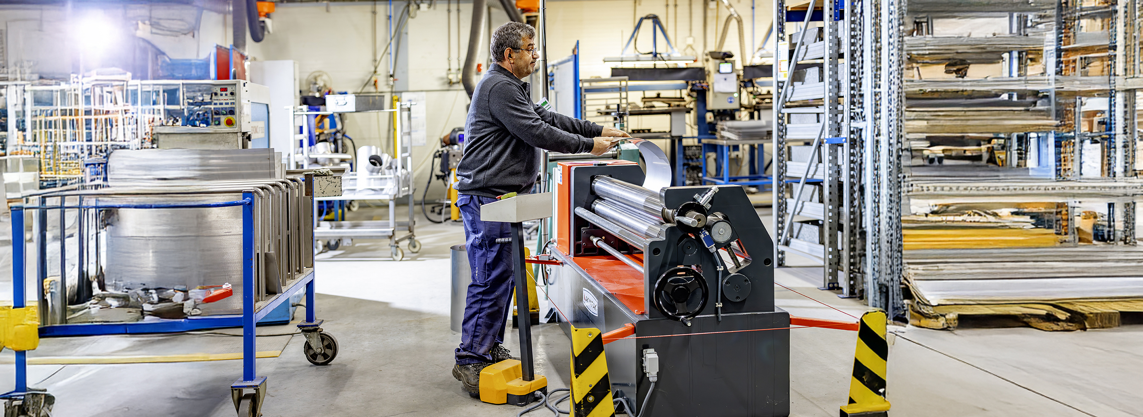
Toolbox
Machine safety: Metal and profile rolling mill
Company name and date

Slide 2

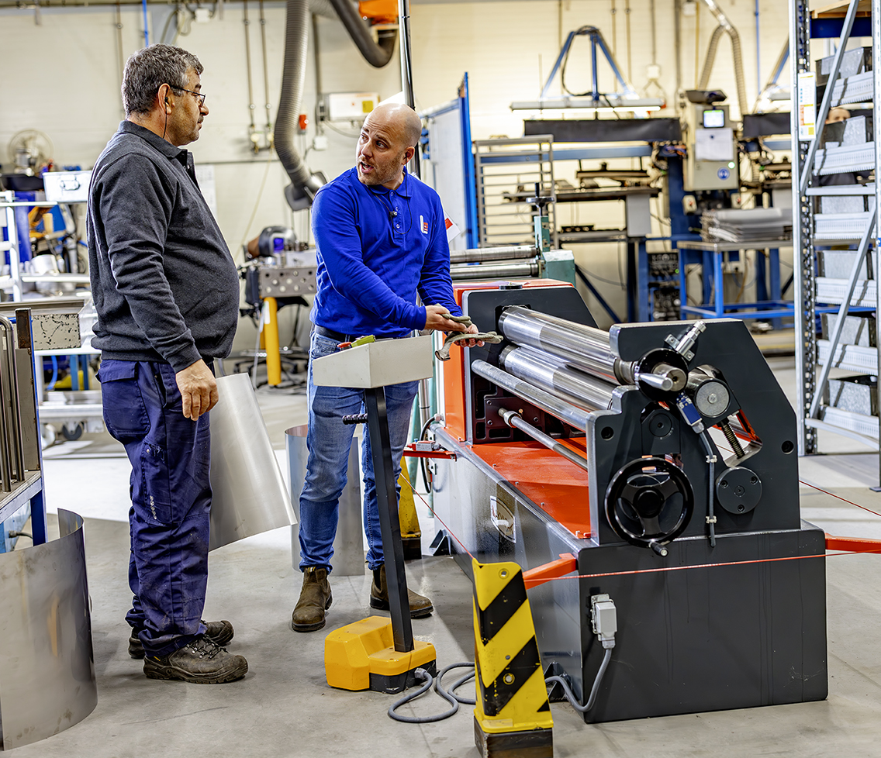
Contents
Safe and healthy working practices | Machine safety: Metal and profile rolling mill
Why machine safety?
Cause of accidents
Safe machine
What can you do yourself?

Slide 3
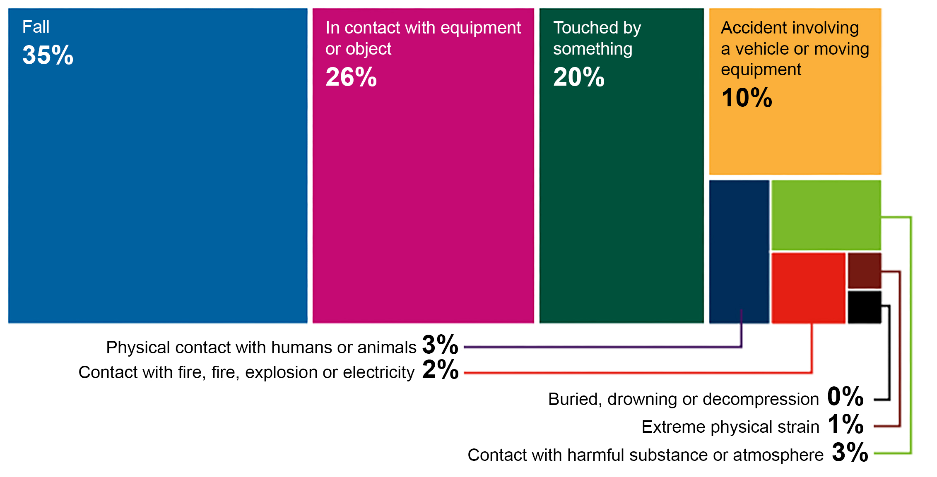
Safe and healthy working practices | Machine safety: Metal and profile rolling mill
Why machine safety?
Accident investigations completed in 2023, broken down by accident type.
Large proportion of the number of reported occupational accidents.
Contact with work equipment or object 26%.
Source: Work Accident Monitor 2023 – Dutch Labour Inspectorate
Notes:
https://www.nlarbeidsinspectie.nl/publicaties/rapporten/2024/08/26/monitor-arbeidsongevallen-2023
The accident type "Contact with work equipment or object" is common in the Industrial sector (42% of accidents in that sector). The majority of accidents involve accidents in which the victim came into contact with moving parts of a machine (69%).

Slide 4
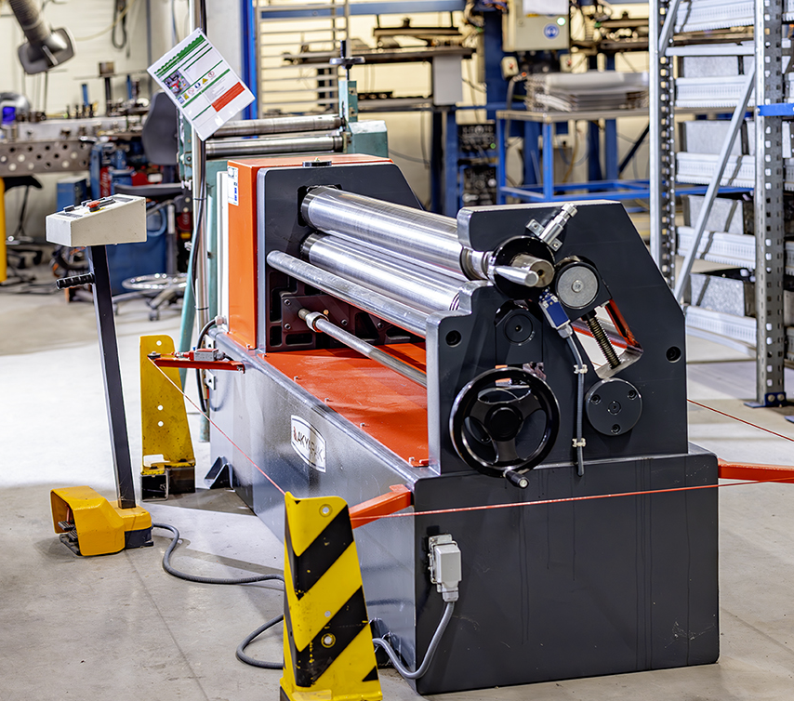
Guard missing.
Safe and healthy working practices | Machine safety: Metal and profile rolling mill
Why machine safety?
Cause of contact with moving parts:
Guard missing, but insufficiently effective.
Guard removed.
Incorrect operation.

Slide 5
Clothing/hair/jewellery and gloves get caught in rotating parts.
Safe and healthy working practices | Machine safety: Metal and profile rolling mill
Cause of accidents involving metal rolling mills
Serious and permanent injury:
Amputation and fractures of fingers, hands, arms or internal injuries. Fractures and large cuts to other parts of the body resulting in loss of function.

Slide 6
Manual or foot control is preferable to automatic mode.
Safe and healthy working practices | Machine safety: Metal and profile rolling mill
Safe machine
Clear rolling direction indicated on the control panel.
Check whether the manual or foot control is equipped with a hold-to-run control or whether it is positioned at a safe distance.
In automatic mode, a safe distance of 1 arm's length must always be maintained.
Check that there is an emergency stop device at every location where the roller is operated.

Slide 7

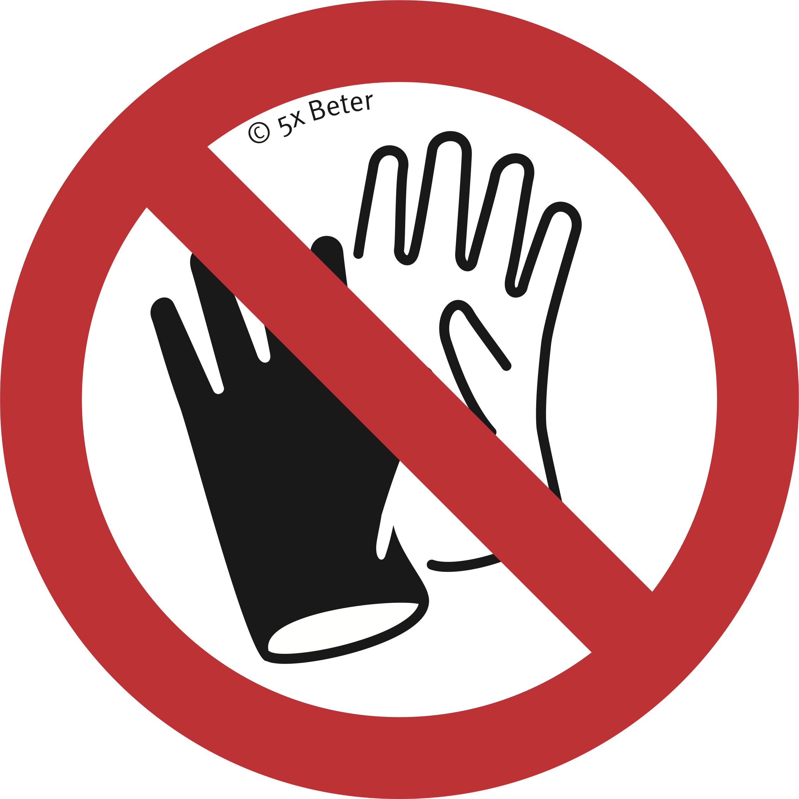
Safe and healthy working practices | Machine safety: Metal and profile rolling mill
What can you do yourself?
Do not wear gloves.
Test the emergency stop.
If safety devices are missing or have been bypassed, discuss this with your manager.
Prevent hair, clothing and jewellery from being caught in the roller.
Remember to keep a safe distance from the roller.
Do not start work if you have any doubts about the safety of the machine; discuss this with your manager.
Never bypass the safety devices.

Slide 8

Safe and healthy working practices | Machine safety: Metal and profile rolling mill
Questions?
info@5xbeter.nl | www.5xbeter.nl

Slide 9
Safe and healthy working practices | Machine safety: Metal and profile rolling mill
Need help?
Discuss it with your manager or contact the health and safety officer.
Consult an Improvement Coach from 5xbeter: www.5xbeter.nl
Or call the FREE Improvement Line: 0800 – 55 55 005
info@5xbeter.nl | www.5xbeter.nl

